Slide 1
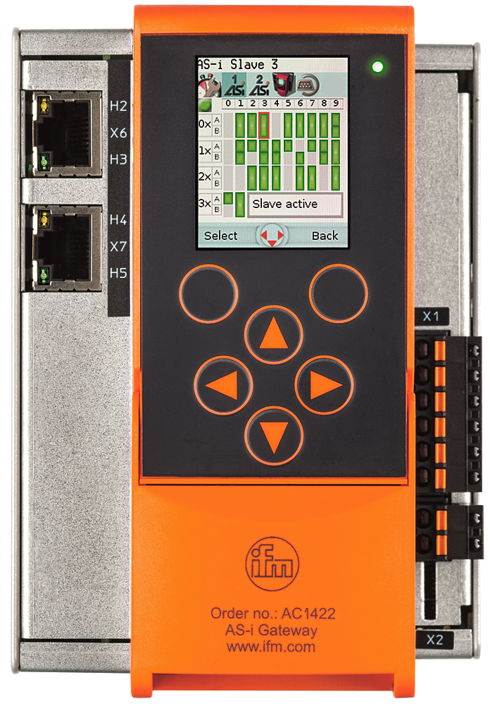
AL1x4x Setup PLC for reading process data
Configuring the AL1x4x IO-Link module
Setup PLC for reading process data

Slide 2
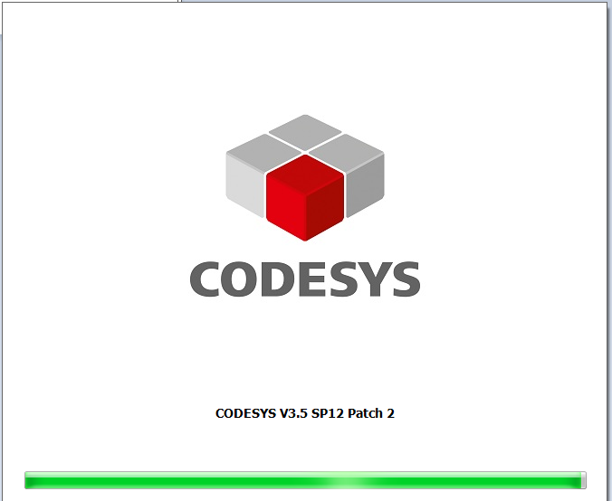
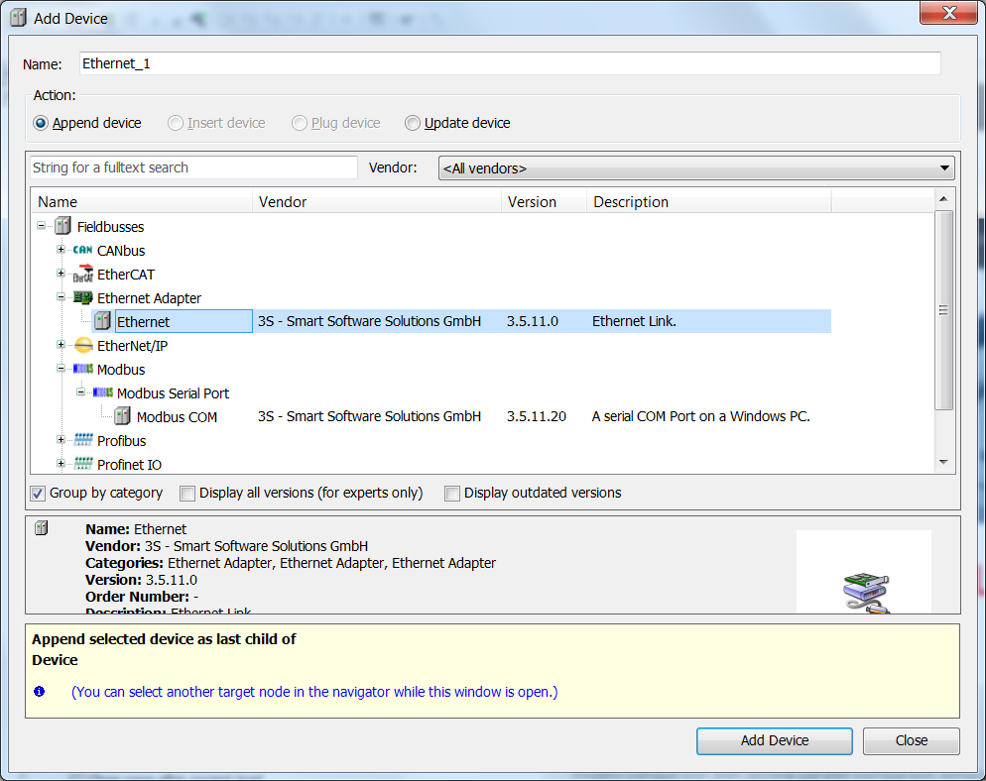
AL1x4x Setup PLC for reading process data
1. Start CODESYS 3.5 SP12
2. Add Device
„Ethernet“ to
your project

Slide 3
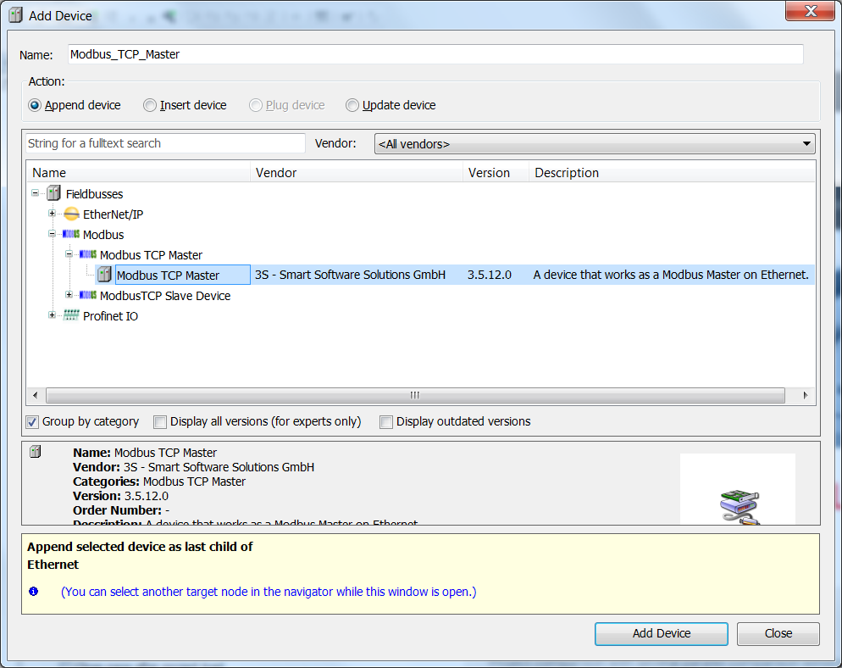
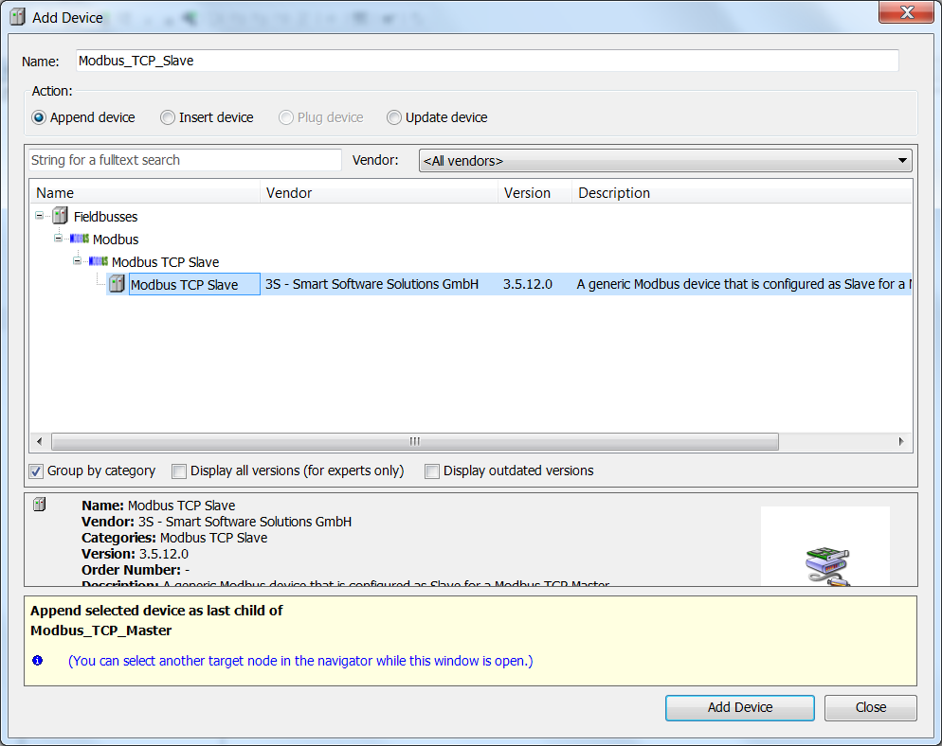
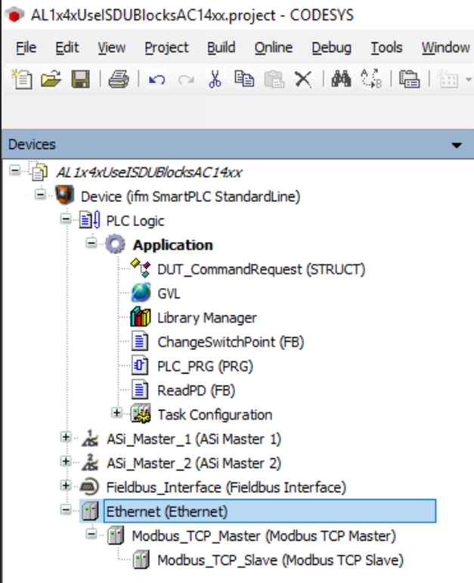
AL1x4x Setup PLC for reading process data
3. Add a Modbus TCP Master
4. Add a Modbus TCP Slave to the Modbus TCP master

Slide 4
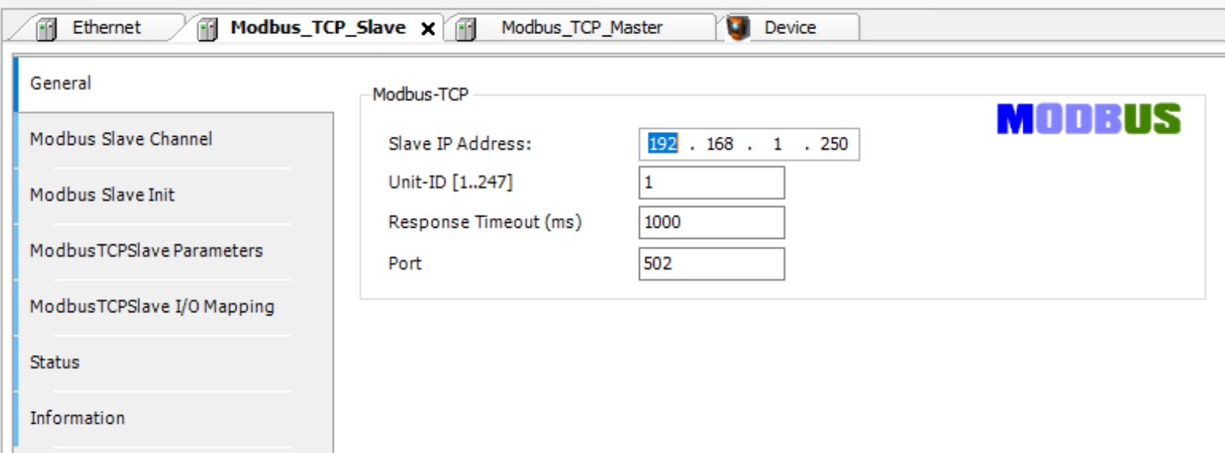
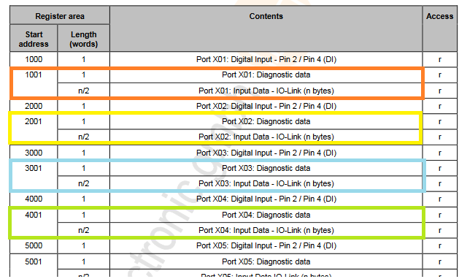
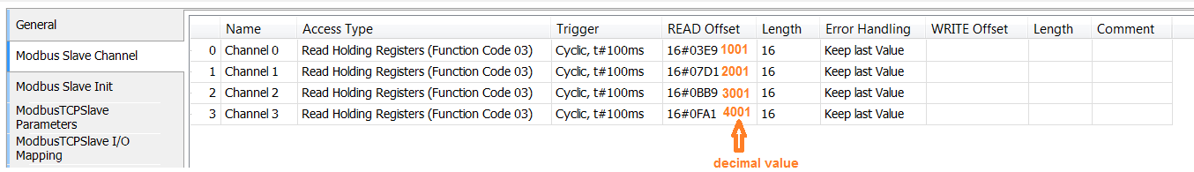
AL1x4x Setup PLC for reading process data
5. Type in the IP –Address of AL1x4x and Unit-ID [1]
6. Add Modbus Channels (Read Holding Registers)

Slide 5
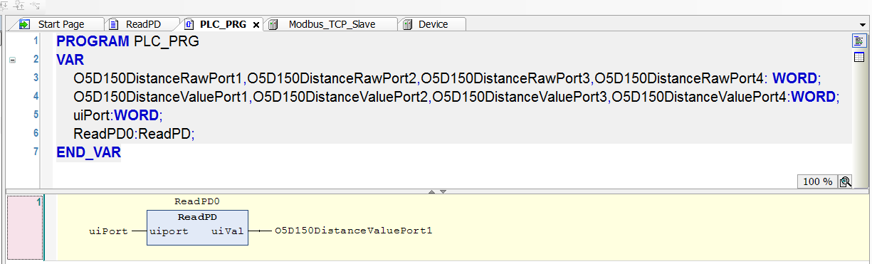
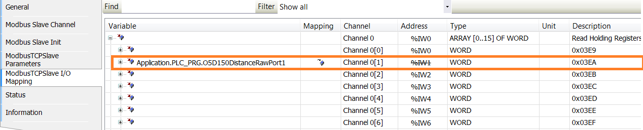
AL1x4x Setup PLC for reading process data
7. Define Variables for each IO-Link port and assign them in the mapping table of Modbus

Slide 6
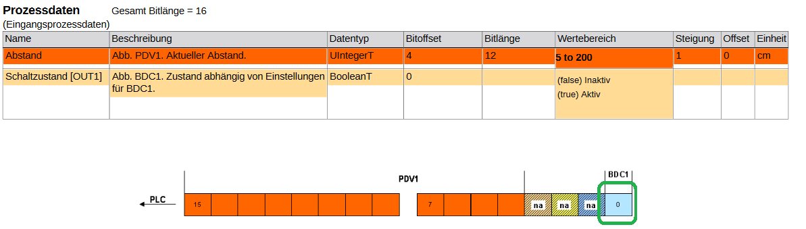
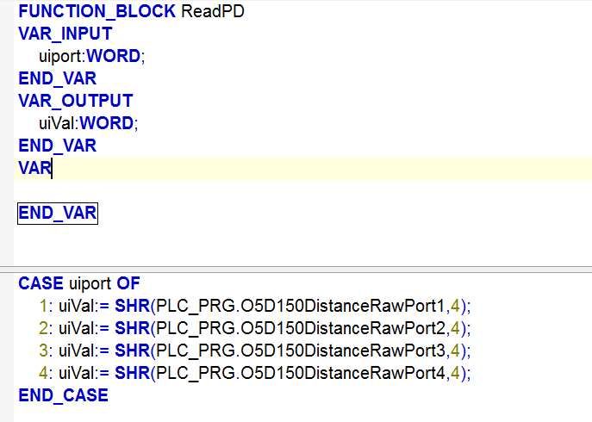
AL1x4x Setup PLC for reading process data
8. Add a function block ReadPD and shift the value for 4 Bits
(see IO-Link description PDF of the O5D150 )

Slide 7
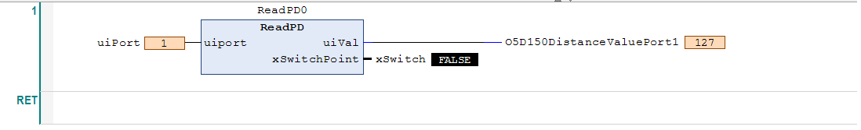
AL1x4x Setup PLC for reading process data
9. Start the CODESYS project on the AC14 PLC
10. Call the function block in your PLC_PRG, compile and download the project to your computer, start the application and type in the port number where the O5D150 is connected to

